Slide 1

Department of Computer & Communication Engineering
Subject: Database Management System(DBMS)
Subject code:BCS403
Topic:Car Rental System
Submitted by:
1KS23CM013
1KS23CM006
1KS23CM045
1KS23CM034
1KS23CM026

Slide 2
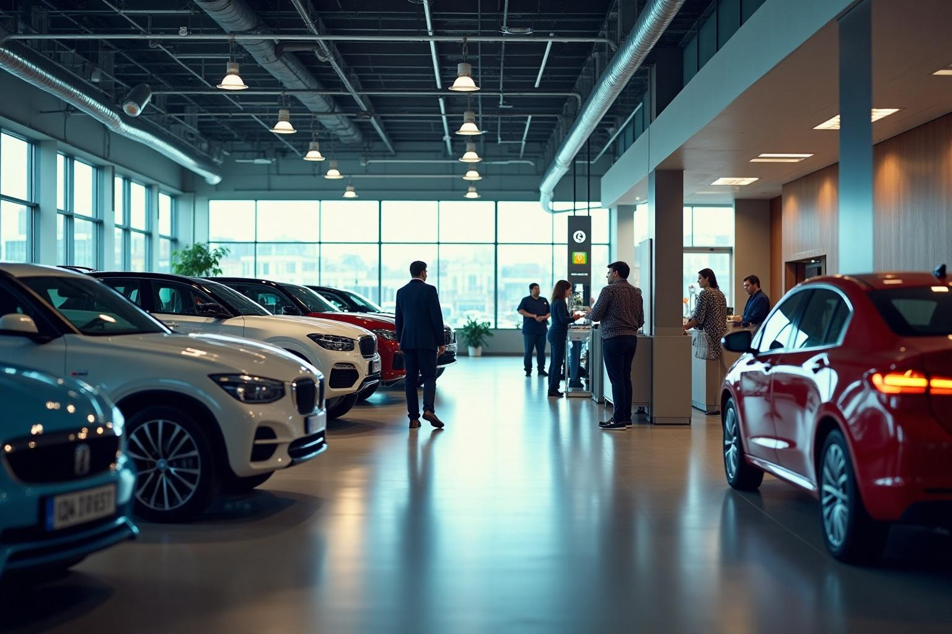
Car Rental System
A Comprehensive Overview of a python,django and MySQL Based Application

Slide 3

Introduction
The Car Rental System is a web-based application developed using Python with the Django framework and MySQL to automate the process of renting cars. It allows users to register, browse available vehicles, book rentals, and manage returns through a user-friendly web interface. Administrators can efficiently manage car inventory, customer records, and view transaction history via the Django admin panel. The system improves operational efficiency, reduces manual errors, and ensures smooth handling of all rental activities.

Slide 4
01
System Overview
The Car Rental System is a web-based application developed using Python with Django and MySQL as the database. It supports two primary user roles:
Admin: Responsible for managing car inventory, customer details, and overseeing rental transactions through the Django admin interface.
Customer: Can browse available vehicles, register, and book rentals via the web interface.
The system leverages Django’s powerful backend to handle business logic and data management, while MySQL stores all persistent data. This setup ensures reliable, efficient, and scalable rental operations with a user-friendly experience for both admins and customer

Slide 5
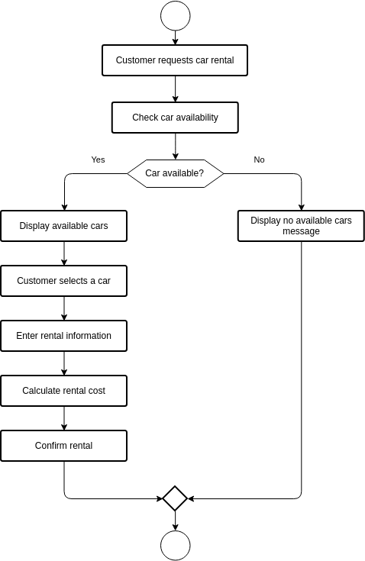
Description of Car Rental System
The Car Rental System is a web-based application developed using Python and Django. It provides a user-friendly interface for both administrators and customers, enabling efficient management of car rentals, bookings, and returns. Customers can search for available vehicles, book them for specific dates, and view their booking history through the web portal. Administrators can add, update, or delete car records, manage customer information, and monitor ongoing rentals via the Django admin panel. The system streamlines rental operations and enhances user experience through its intuitive design.

Slide 6
Importance of System
The Car Rental System simplifies and automates the vehicle rental process, reducing manual effort and errors. It ensures efficient management of bookings, returns, and vehicle availability. By digitizing records and operations, the system improves accuracy, saves time, enhances customer experience, and supports better decision-making for rental businesses.

Slide 7
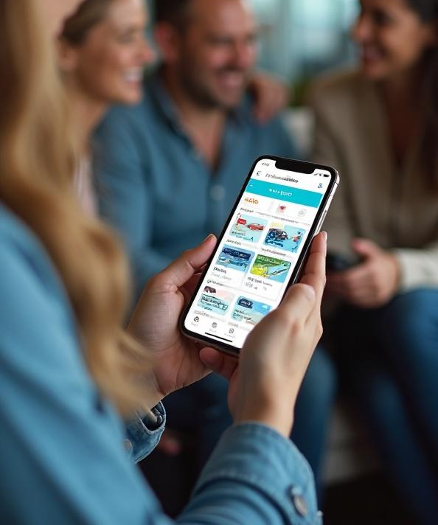
Key Features-
The Car Rental System offers several key features, including:
Real-time vehicle availability to ensure customers can only book cars that are free.
Online booking capabilities allowing users to reserve vehicles conveniently through the web interface.
User authentication for secure login and registration of both customers and administrators.
Admin panel powered by Django for managing car inventory, customer records, and rental transactions efficiently.
Booking history for customers to view their past and current rentals

Slide 8
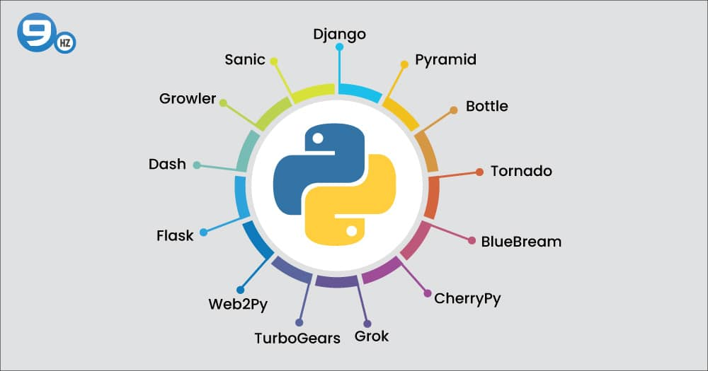
Frameworks Used
The system is built using Python, leveraging the Django framework for rapid development, built-in ORM, and secure, scalable web application architecture. Django’s powerful admin interface facilitates easy management of the system. For data storage and ORM, MySQL is used as the relational database system. The user interface is developed using Django’s templating system, providing dynamic and responsive web pages.

Slide 9

MySQL Database Design
The MySQL database is designed to efficiently handle various data requirements, including user accounts, vehicle listings, booking history, and payment records. The schema is normalized to reduce redundancy and optimize query performance.

Slide 10
Software and Hardware Requirements
Software Requirements:
Python 3.7 or higher
Django framework (version 4.x or later)
MySQL Server for database management
A code editor or IDE such as Visual Studio Code, PyCharm, or any text editor
Web browser (Chrome, Firefox, Edge, etc.) to access the application
Hardware Requirements:
Minimum 4GB RAM
Modern processor (Intel i3 or equivalent and above)
Sufficient storage space to host the database and application files
Network connectivity for web access
This environment ensures smooth development, testing, and deployment of the car rental system.

Slide 11
Conclusions
The Car Rental System successfully automates the process of renting vehicles, making it faster, more accurate, and user-friendly. By integrating Python,django for the application logic and MySQL for data management, the system streamlines car bookings, returns, and administrative tasks. It reduces manual work, minimizes errors, and improves service quality, making it a valuable tool for modern car rental businesses.

